Slide 1
support
HIPP MPE Library
(Out-of-standard Enhancement)
HIPP High-level MPI Library
(Pure-OOP Interfaces, Memory Management)
support
support
HIPP CNTL Library
(Exception Layers, Stream Manipulation, Memory Management Utilities ...)
Member
support
HIPP Low-level MPI Library
(Semi-OOP Interfaces, Exception Handling)
support
Member
support
MPI Standard Implementation
(OpenMPI, MPICH, ...)

Slide 2
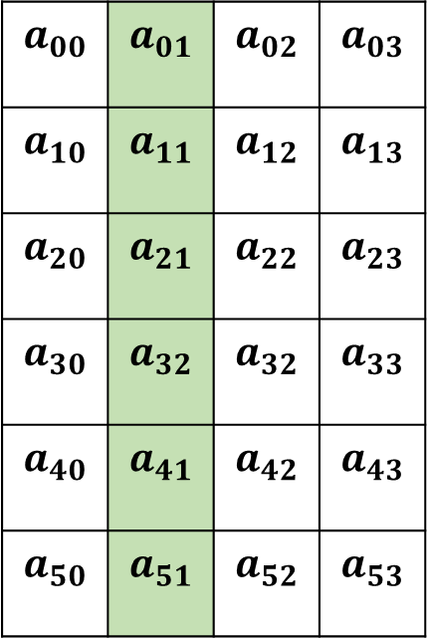
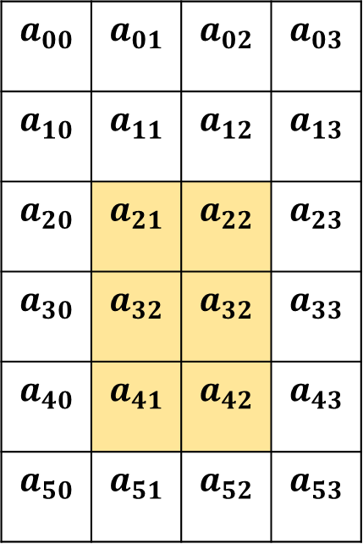


$$A_{1}$$
$$A_{2}$$
$$a_{00}$$ | $$a_{01}$$ | $$a_{02}$$ | $$a_{03}$$
$$a_{10}$$ | $$a_{11}$$ | $$a_{12}$$ | $$a_{13}$$
$$a_{20}$$ | $$a_{21}$$ | $$a_{22}$$ | $$a_{23}$$
$$a_{30}$$ | $$a_{32}$$ | $$a_{32}$$ | $$a_{33}$$
$$a_{40}$$ | $$a_{41}$$ | $$a_{42}$$ | $$a_{43}$$
$$a_{50}$$ | $$a_{51}$$ | $$a_{52}$$ | $$a_{53}$$
$$a_{00}$$ | $$a_{01}$$ | $$a_{02}$$ | $$a_{03}$$
$$a_{10}$$ | $$a_{11}$$ | $$a_{12}$$ | $$a_{13}$$
$$a_{20}$$ | $$a_{21}$$ | $$a_{22}$$ | $$a_{23}$$
$$a_{30}$$ | $$a_{32}$$ | $$a_{32}$$ | $$a_{33}$$
$$a_{40}$$ | $$a_{41}$$ | $$a_{42}$$ | $$a_{43}$$
$$a_{50}$$ | $$a_{51}$$ | $$a_{52}$$ | $$a_{53}$$
world.send(dest, tag, &a[2][1], 1, DOUBLE.vector(3, 2, 4));
world.send(dest, tag, &a[0][1], 1, DOUBLE.vector(6, 1, 4));

Slide 3






Comm world;
Process 0
Process 1
Process 2
Process 3
vector<double>
rands;
$$a_{0}$$ | $$a_{1}$$ | $$a_{2}$$ | $$a_{3}$$
Before
scatter
double
local_rand;
vector<double>
rands;
$$a_{0}$$ | $$a_{1}$$ | $$a_{2}$$ | $$a_{3}$$
After
scatter
world.scatter();
double
local_rand;
$$a_{0}$$
$$a_{1}$$
$$a_{2}$$
$$a_{3}$$

